Slide 1
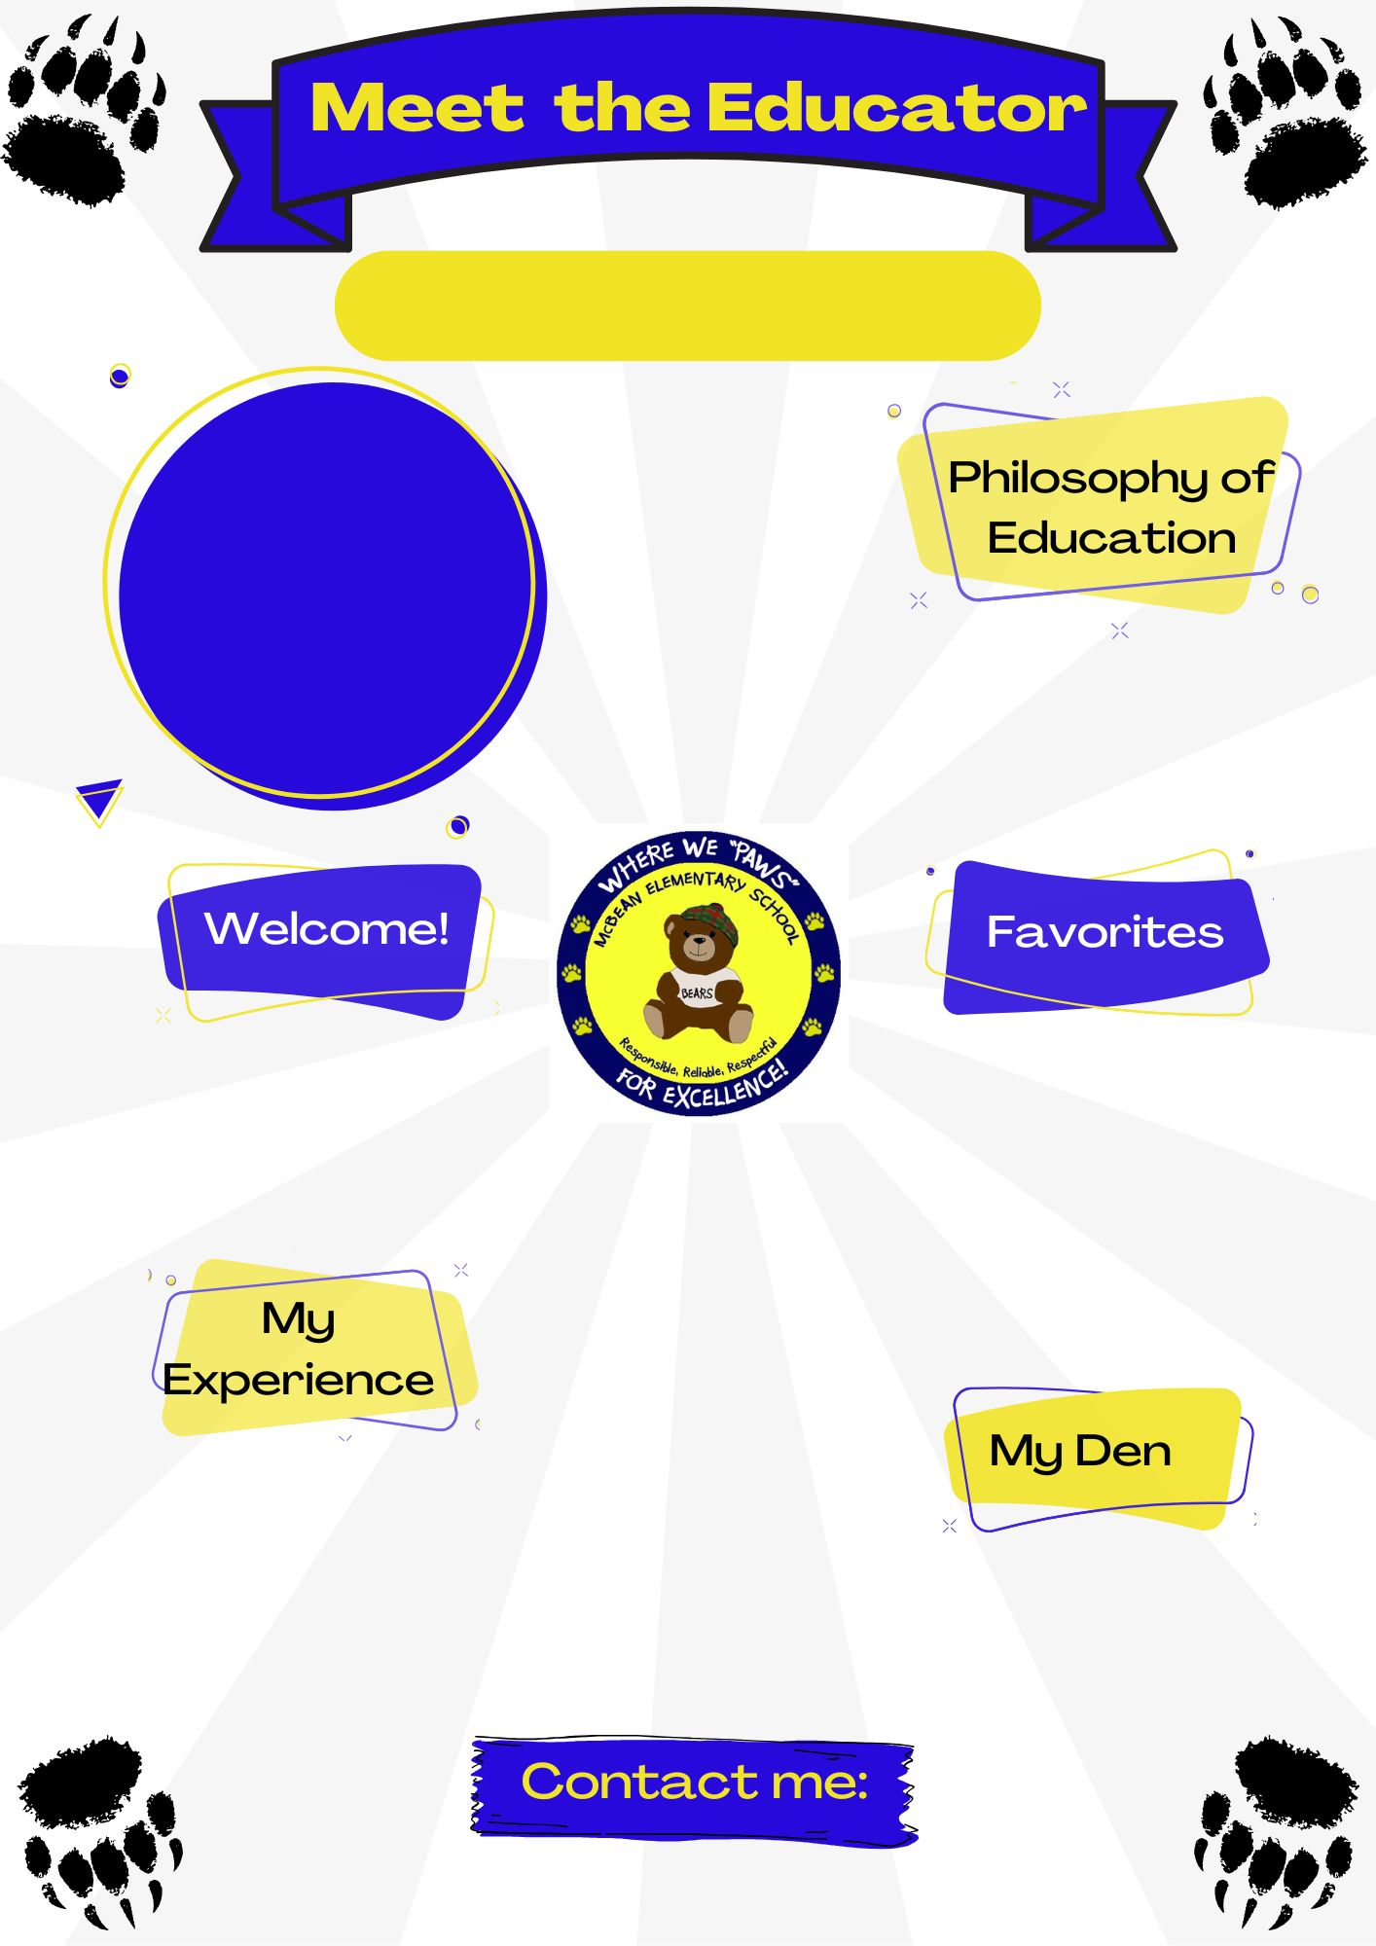
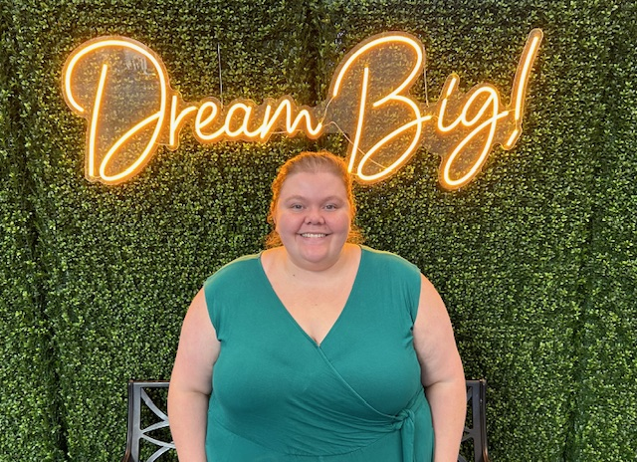

Ms. Valentie
Insert picture here
I believe that education should be equitable. Every student should have the same opportunity to learn.
Hello! Welcome to Kindergarten! I am super excited for this year, and can’t wait to meet all of you!
Color(s): Yellow
Animal(s): Guinea Pigs
Hobby: Baking and reading
Sport: softball
Book: The Penelope Rex series
Movie: The Little Mermaid
Food: Pickles
Drink: Cherry Coca Cola
This is my Fourth year teaching, and my first year teaching kindergarten. I have my masters degree in early childhood education from Augusta University!
@boe.richmond.k12.ga.us

